Slide 1




Compose Check
Filter
Name
1
Report
ID
12
All
Milestone Is Achieved But Invoice Has Not Been Sent
Invoice_Milestone
Category
Status
Ready for Testing
2
URL
Description
ProjectorPSA.com/ProjectLanding/
%Variable/setup
Severity
Warning
Select Check
→
260 | Project Revenue Recognized but…
262 | Project Stage is Active signed, Ac…
263 | Project Has No Engagement Man…
264 | Project’s Time Contract Terms are…
270 | Project Person Hours Booked Are…
271 | Project Resource Rate is Not Equ…
272 | Project Pipeline Notes are Missing…
273 | Engagement has no Associated…
274 | Project Resource 1 Individual Sal…
275 | Project Resource 1 Individual Ma…
276 | Project Resource 1 Team Sales P…
277 | Project Resource 1 Team Margin…
278 | Project Resource 2 Team Sales P…
279 | Project Resource 2 Team Margin…
280 | Project Resource 3 Team Sales P…
281 | Project Resource 3 Team Margin…
282 | Project Resource 4 Team Sales P…
283 | Project Resource 4 Team Margin…
284 | Project Resource 5 Team Sales P…
285 | Project Resource 5 Team Margin…
288 | Project Description Required
289 | Purchase Order Required at Cont…
290 | Milestone is Achieved But Invoice…
291 | Milestones Required for a Billable…
Produces an error if milestone status is Achieved and milestone date is more than one week old
Add New Check
Key Field
Project UID
Save Check
Message
Test Check
3
Alert
Frequency
Milestone is more than one week past due
4
Cynthia Logan
Daily
DELETE
Check Failure Conditions:
5
Add Condition
Edit | 100 |  |  | Milestone Status | Equal to | “Achieved”
Edit | 200 |  | AND | Invoice Status | Is empty
X
X
47 checks
1 | Confidential rGen Materials

Slide 2
Login and Setup Screens
Login Name
Login Name
Login Name
New user created
A confirmation email has been sent to cynthia@compuserve.com
*
cynthia@compuserve.com
*
cynthia@compuserve.com
*
cynthia@compuserve.com
Password
Password
New Password
*
******************
*
******************
*
******************
Return to Login
Login
Confirm Password
Confirm New Password
******************
******************
Password request received
A reset email has been sent to cynthia@compuserve.com
*
*
Create Account
Create Account
Save
Forgot Password?
Cancel
Cancel
Return to Login
Password reset
You may now log in using your new password
Return to Login
2 | Confidential rGen Materials

Slide 3
Popout Screens
1
1
2
3
Select Report
Add new Report
Enter URL
Alert
Project
Project List
Invoice
Revenue Recognition
Time Card
Resource
Invoice Milestone
Rate Card
Report Name
URL base
Cynthia Fallon
George Romero
Gary Johnson
Larry Grant
Stacey Plunkett
Ted Norton
Edward Shale
Claire Shelton
Marty Funkhauser
Carol Horton
✓
*
Client
ProjectorPSA.com/ProjectLanding/
%Variable/setup
✓
✓
*
Report Spec UID
*
✓
https://app4.projectorpsa.com/report/code/Resource?format=csv&columnheaders=firstrow&UserName=acctg%40rgenconsulting.com&AccountCode=rGen&AuthToken=d98688e7-d7d3-4e6f-bb6c-4103d54b878b
✓
✓
URL prefix
✓
DELETE
Add Report
*
ProjectLanding
Save
*
URL suffix
Report Status
setup
Released
*
*
Save
3 | Confidential rGen Materials

Slide 4


Popout Screens
4
4
4
4
5
Frequency
Frequency
Frequency
Frequency
Add new condition
Send alerts
Daily
Weekly
Monthly
Yearly
Recur every
day(s)
weekday
Range of recurrence
Start on:
End by:
Send alerts
Daily
Weekly
Monthly
Yearly
Recur every
week(s) on:
Sunday
Monday
Tuesday
Wednesday
Thursday
Friday
Saturday
Range of recurrence
Start on:
End by:
Send alerts
Daily
Weekly
Monthly
Yearly
Recur every
day of every
month(s)
of every
months
Range of recurrence
Start on:
End by:
Send alerts
Daily
Weekly
Monthly
Yearly
Recur every
year(s)
on
of
Range of recurrence
Start on:
End by:
Order
*
1
Connection with previous condition
*
And
1
1
1
1
1
March
1
Open Bracket
✓
third
third
Monday
✓
✓
March
Field
Mon 3/20/2023
1
*
Project Code
Mon 6/20/2023
Mon 3/20/2023
Is equal to
Mon 3/20/2023
Mon 6/20/2023
*
Mon 6/20/2023
Field Value
Mon 3/20/2023
*
EN00001-001
Mon 6/20/2023
Close Bracket
✓
Save
4 | Confidential rGen Materials

Slide 5
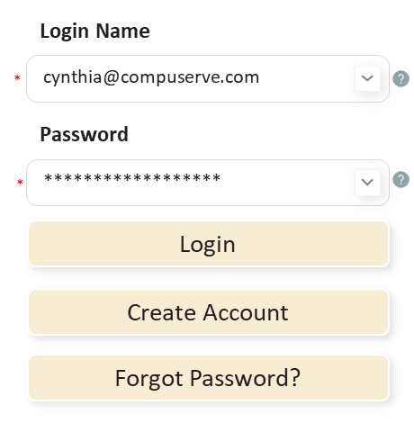
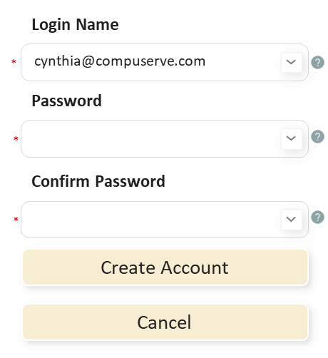
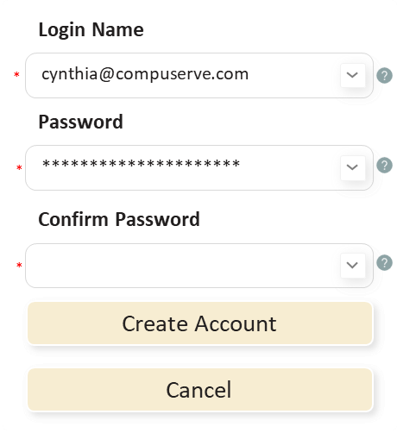
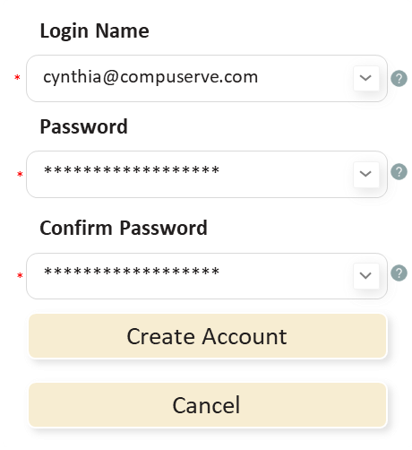
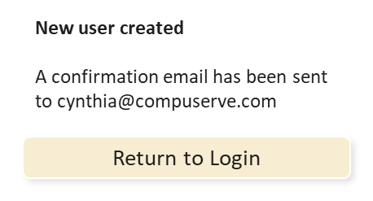
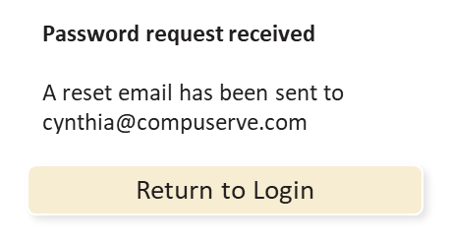
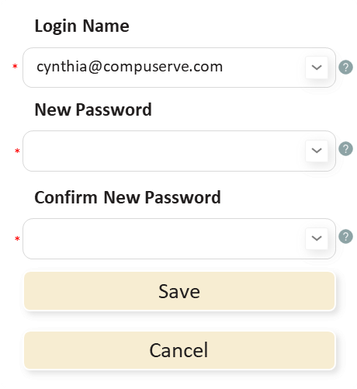
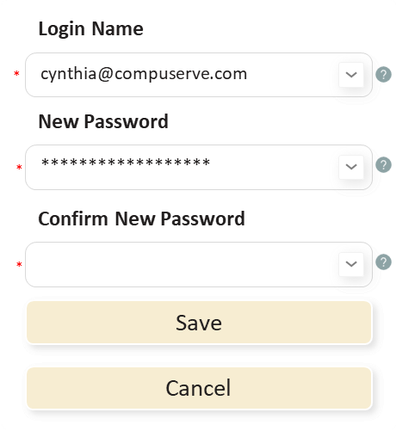
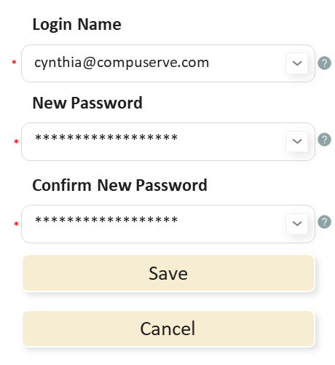
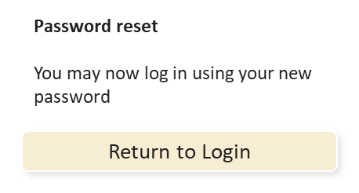
Initial Setup Process
User creates account
User logs in
User clicks “Create Account”
User enters their email address
User enters their password
User confirms their password
User clicks “Create Account”
User sees confirmation
User enters their email address
User enters their password
User clicks “Login”
User resets password
User clicks “Forgot Password?”
User sees reset confirmation
Email links to password reset
User enters their new password
User confirms their new password
User clicks “Save”
User sees confirmation

Slide 6
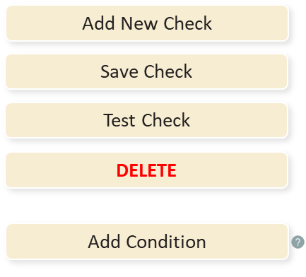
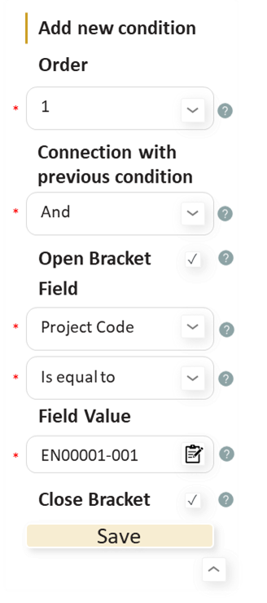
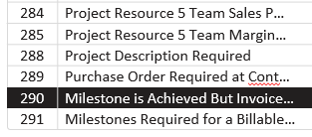

Check Modification Process
Adding Checks
Delete Unnecessary Checks
User clicks “add check”
User enters check details
User adds a condition
User defines check conditions
User saves check conditions
User selects check to be deleted
User deletes check
Name
Description
Message
Report
URL
Key Field
Unique ID
Status
Severity
Check order
Connector
Open brackets field
Operator
Field value
Close bracket
Changing Checks
User clicks “add check”
If necessary, user adds a condition
User defines new conditions
User defines new conditions
If necessary, user deletes conditions
Name
Description
Message
Report
URL
Key Field
Unique ID
Status
Severity
Check order
Connector
Open brackets field
Operator
Field value
Close bracket

Slide 7
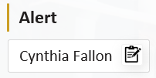
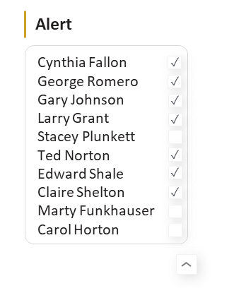
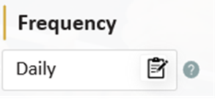
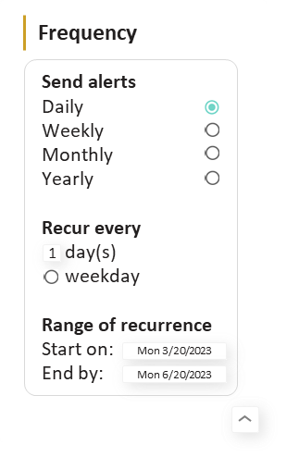
Alert Setup Proces
Setting up alerts
User opens alerts screen
User defines the alert
User closes the alerts screen
User opens the frequency screen
User defines alert frequency
User defines alert frequency
User closes the frequency screen
Modifying alerts
User opens alerts screen
User redefines the alert
User closes the alerts screen
User opens the frequency screen
User redefines alert frequency
User redefines alert frequency
User closes the frequency screen

